Slide 1
Introduction to Trees, Binary Tree, Complete Binary tree

Slide 2
Outline
In this topic, we will cover:
Definition of a tree data structure and its components
Concepts of:
  Root, internal, and leaf nodes
  Parents, children, and siblings
  Paths, path length, height, and depth
  Ancestors and descendants
  Ordered and unordered trees
  Subtrees
Examples

Slide 3
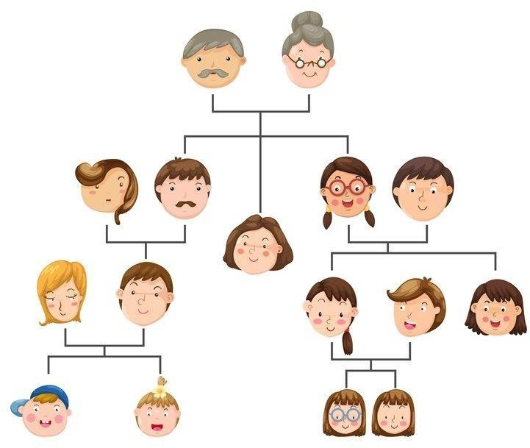
Why Trees Structure?

Slide 4
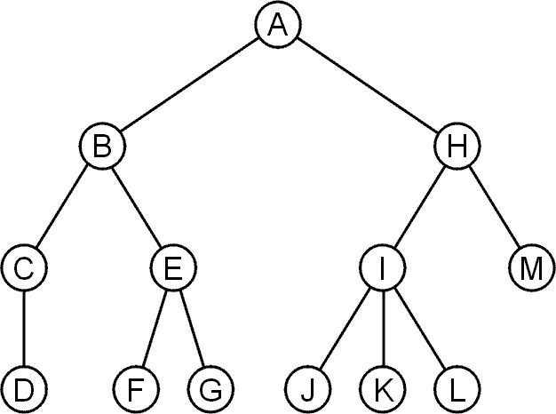
Trees
A rooted tree data structure stores information in nodes
Similar to linked lists:
  There is a first node, or root
  Each node has variable number of references to successors
  Each node, other than the root, has exactly one node pointing to it

Slide 5
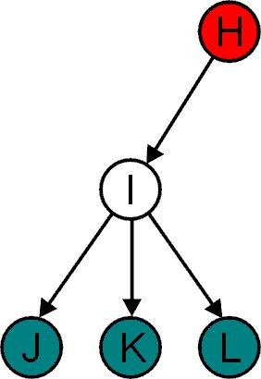
Terminology
All nodes will have zero or more child nodes or children
– I has three children:
J, K and L
For all nodes other than the root node, there is one parent node
– H is the parent I

Slide 6
Terminology
The degree of a node is defined as the number of its children:
deg(I) = 3
Nodes with the same parent are siblings
– J, K, and L are siblings

Slide 7
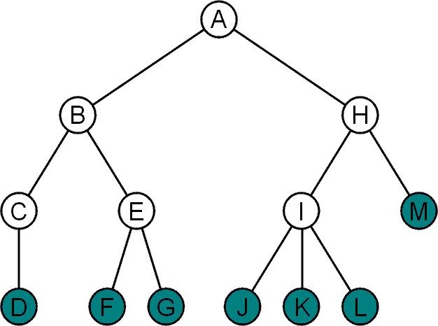
Terminology
Nodes with degree zero are also called leaf nodes
All other nodes are said to be internal nodes, that is, they are internal to the tree

Slide 8
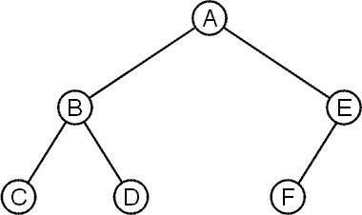
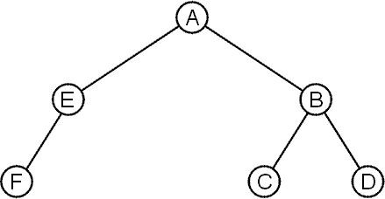
Terminology
These trees are equal if the order of the children is ignored
– unordered trees
They are different if order is relevant (ordered trees)
We will usually examine ordered trees (linear orders)
In a hierarchical ordering, order is not relevant

Slide 9
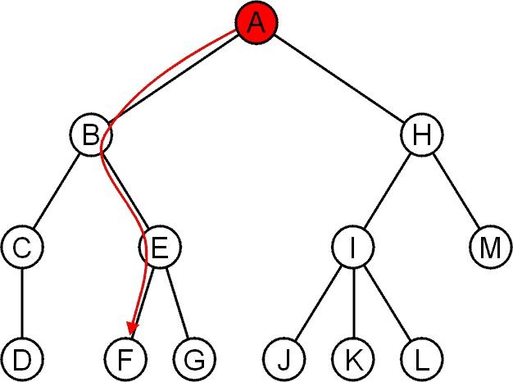
The shape of a rooted tree gives a natural flow from the
root node, or just root

Slide 10
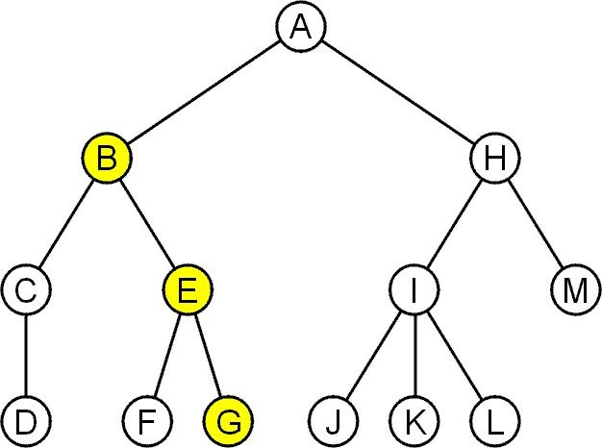
Terminology
A path is a sequence of nodes
(a₀, a₁, ..., a_{n})
where a_{k + 1} is a child of a_{k} is
The length of this path is n
E.g., the path (B, E, G) has length 2

Slide 11
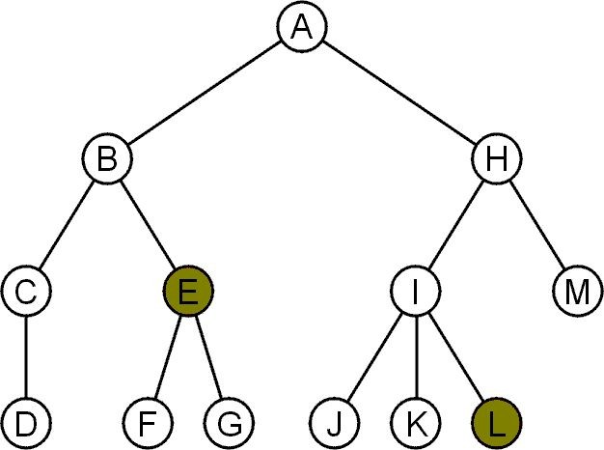
Terminology
For each node in a tree, there exists a unique path from the root node to that node
The length of this path is the depth of the node, e.g.,
E has depth 2
L has depth 3

Slide 12
Terminology
The height of a tree is defined as the maximum depth of any node within the tree
The height of a tree with one node is 0
– Just the root node
For convenience, we define the height of the empty tree to be –1

Slide 13
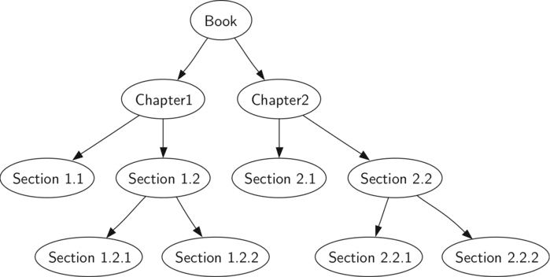
Terminology

Slide 14
Terminology
If a path exists from node a to node b:
a is an ancestor of b
b is a descendent of a
Thus, a node is both an ancestor and a descendant of itself
The root node is an ancestor of all nodes

Slide 15
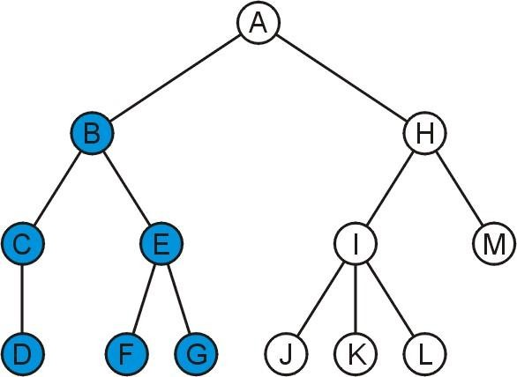
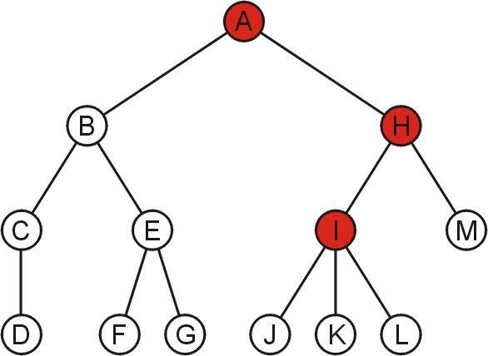
Terminology
The descendants of node B are B, C, D, E, F, and G:
The ancestors of node I are I, H, and A:

Slide 16
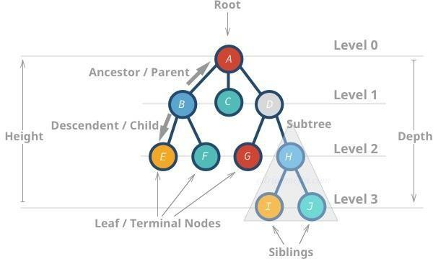
Summarized Terminologies

Slide 17
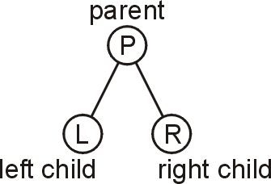
A Binary Tree
A binary tree is a restriction where each node has exactly two children:
Each child is either empty or another binary tree
This restriction allows us to label the children as left and right subtrees

Slide 18
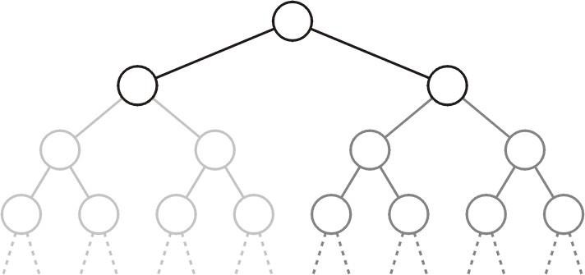
Binary Sub-trees
We will also refer to the two sub-trees as
The left-hand sub-tree, and
The right-hand sub-tree

Slide 19
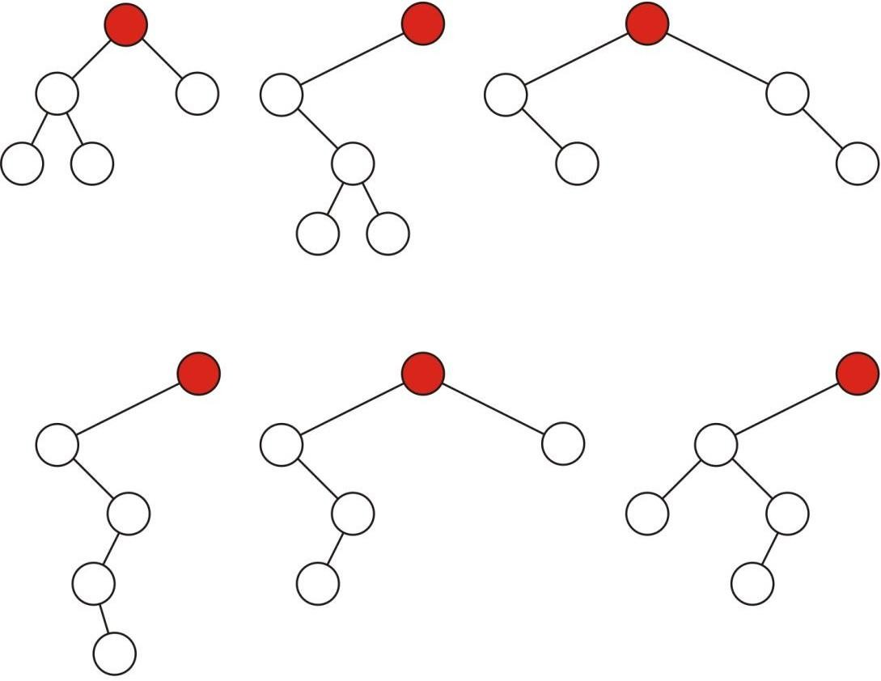
Sample Binary Trees
Sample variations on binary trees with five nodes:

Slide 20
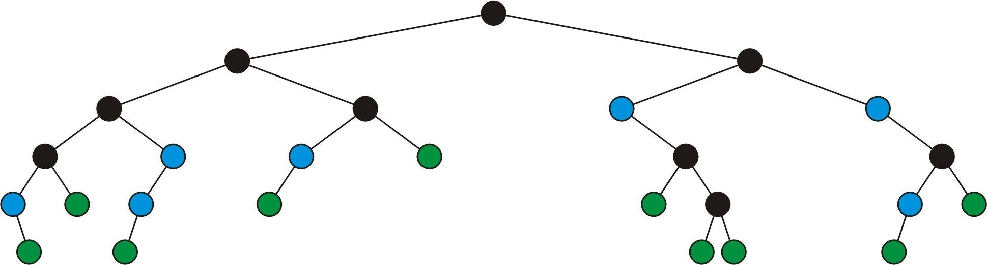



Definition (Full Node)
A full node is a node where both the left and right sub-trees are non- empty trees
Legend:
full nodes
neither
leaf nodes

Slide 21
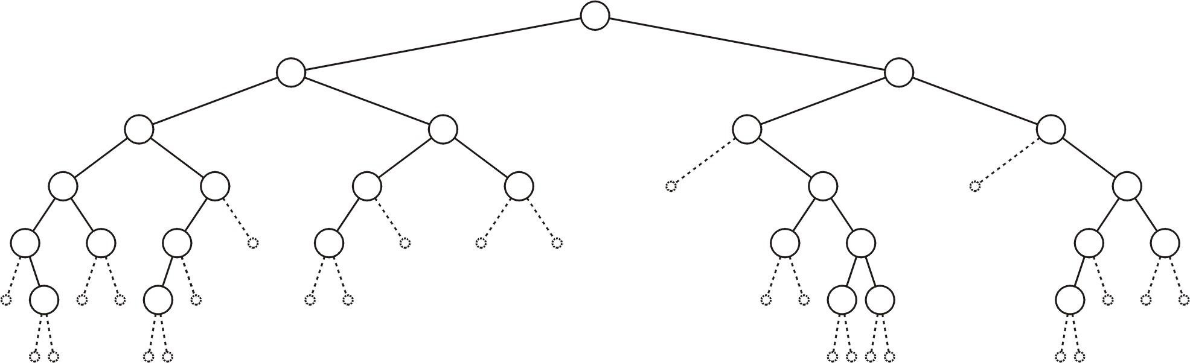
Definition(Empty Node)
An empty node or a null sub-tree is any location where a new leaf node could be appended

Slide 22
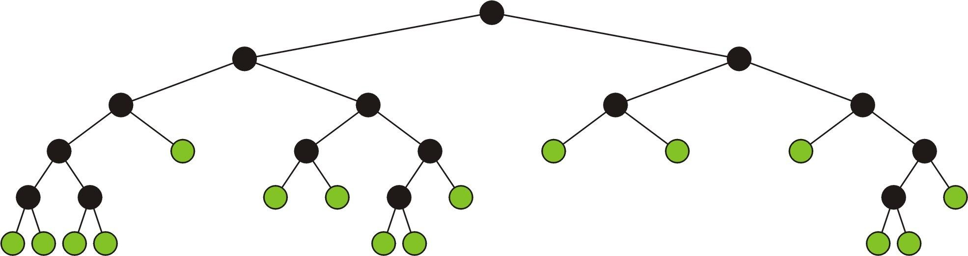
Full Binary Tree
A full binary tree is where each node is:
A full node, or
A leaf node
These have applications in
Expression trees
Huffman encoding

Slide 23
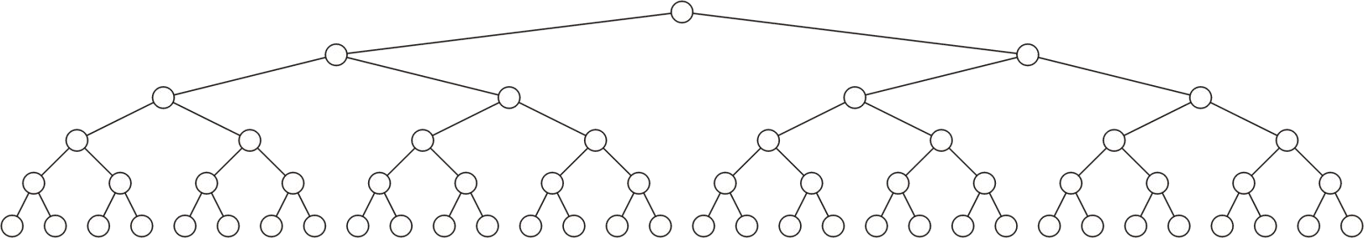
Perfect Binary tree
Standard definition:
A perfect binary tree of height h is a binary tree where
  All leaf nodes have the same depth h
  All other nodes are full

Slide 24
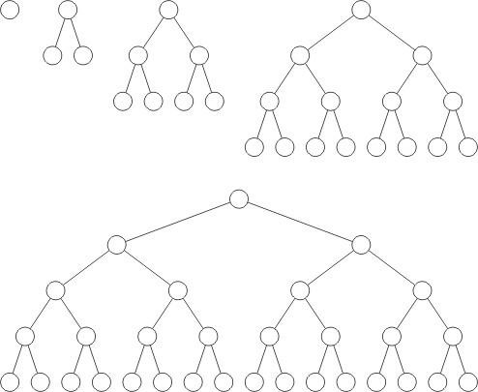
Examples
Perfect binary trees of height h = 0, 1, 2, 3 and 4

Slide 25
Perfect Binary trees
Perfect binary trees are considered to be the ideal case
– The height and average depth are both Θ(ln(n))
We will attempt to find trees which are as close as possible to perfect binary trees
One of the limitations of perfect binary trees is restricted number of nodes.

Slide 26
Complete Binary trees
We require binary trees which are
Similar to perfect binary trees, but
Defined for all n

Slide 27
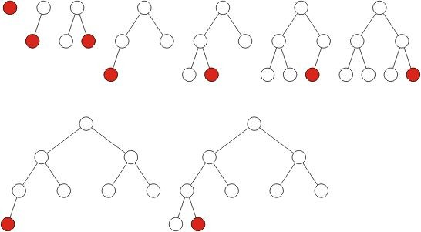
Complete Binary Trees
A complete binary tree filled at each depth from left to right:

Slide 28
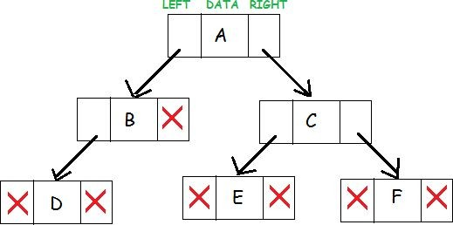
Implementation Details Structure of a Node
Struct node{ int data; node* right; node* left;
};
Struct node* newNode(int value){
node->data=valu e;
Node->left=NULL
;
Node->right=NUL L; Return (node);
}

Slide 29
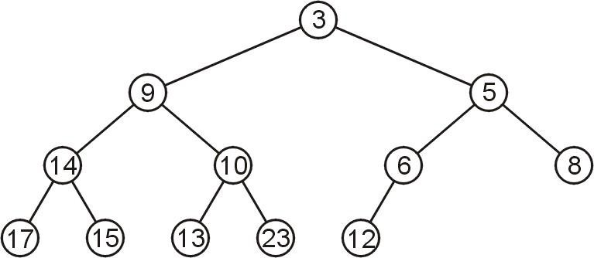
Array Storage
We are able to store a complete tree as an array
– Traverse the tree in breadth-first order, placing the entries into the array

